Slide 1
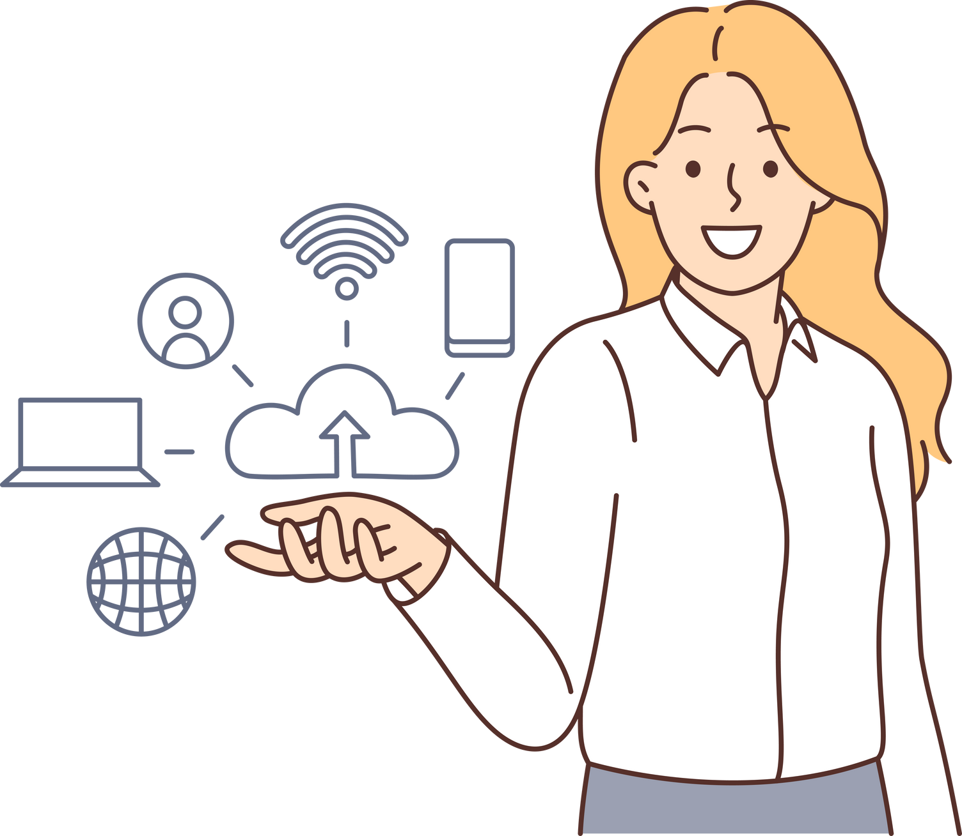
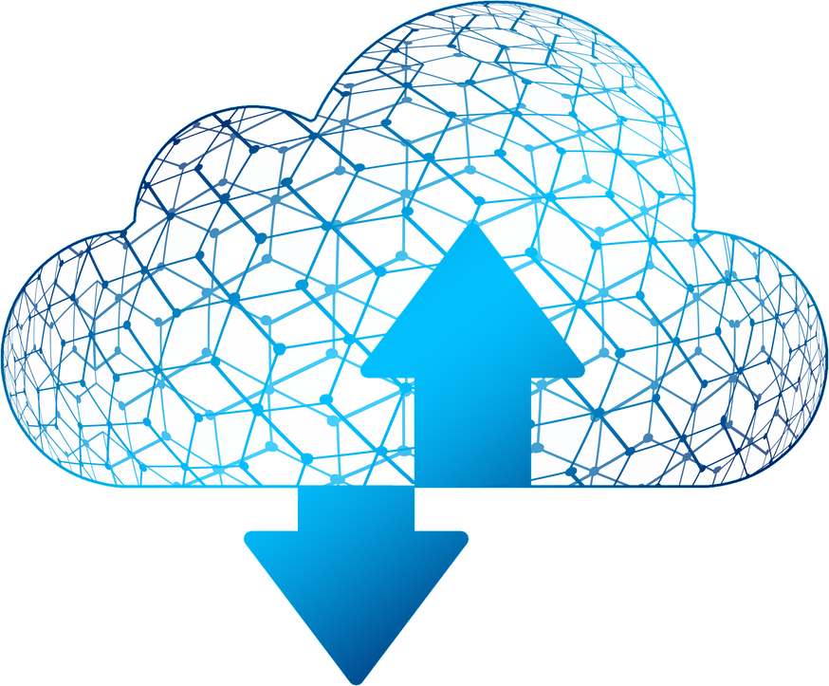
STEMUP
CLOUD
COMPUTING

Slide 2

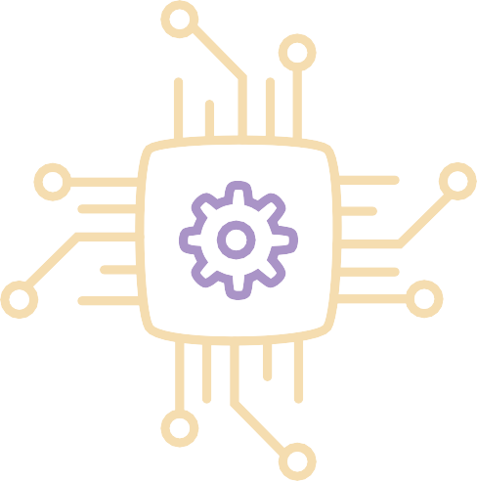
On-demand delivery of IT resources over the Internet with pay-as-you-go pricing..
STEMUP
CLOUD COMPUTING

Slide 3
Access computing resources (like servers, storage, databases, and software) over the internet, rather than owning and maintaining physical hardware.
STEMUP

Slide 4

Amazon Web Services (AWS) Microsoft Azure
Google Cloud Platform (GCP) IBM Cloud
Oracle Cloud Alibaba Cloud DigitalOcean Salesforce VMware Cloud Rackspace Cloud

Slide 5


Slide 6
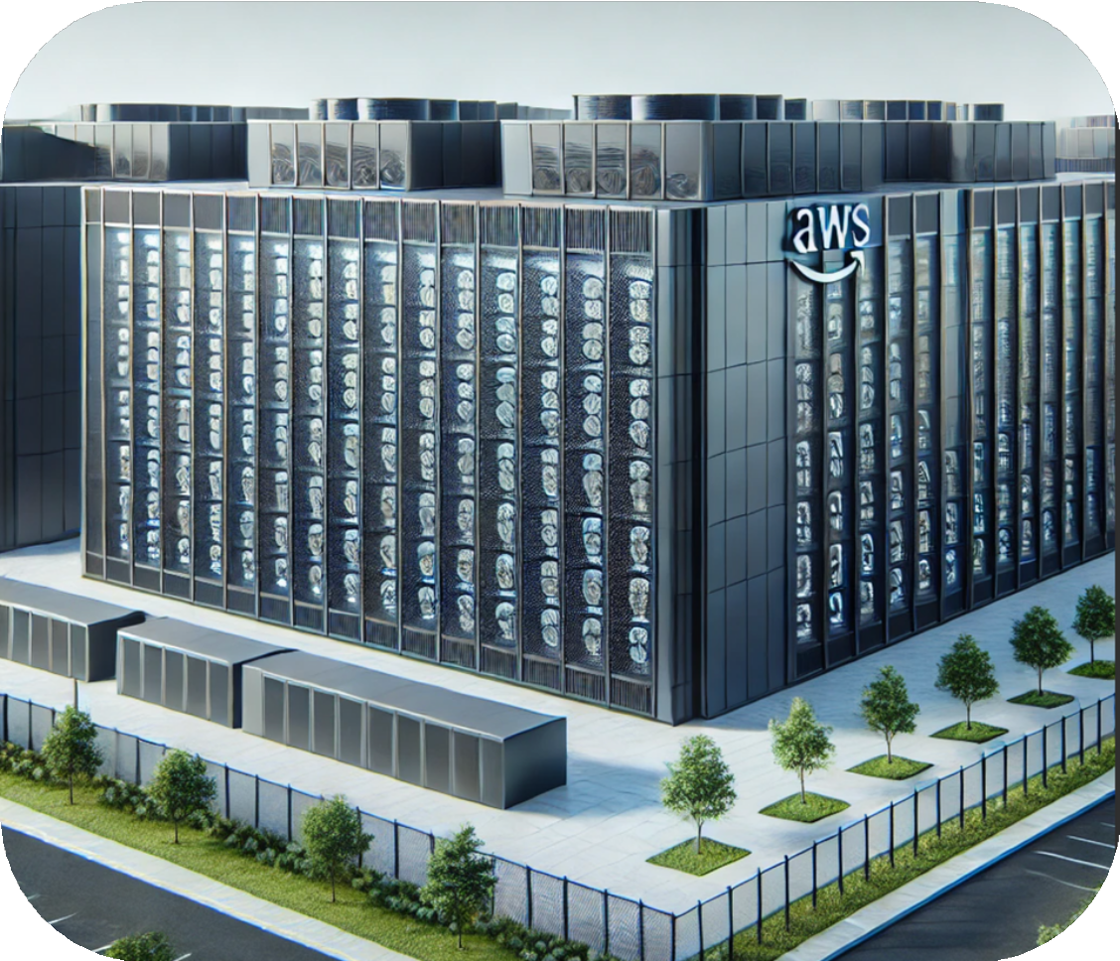

WWS

Slide 7
Virtualization is the process of creating multiple simulated environments or virtual machines from a single physical hardware system, enabling more efficient resource use.

Slide 8


Slide 9












Slide 10







Slide 11


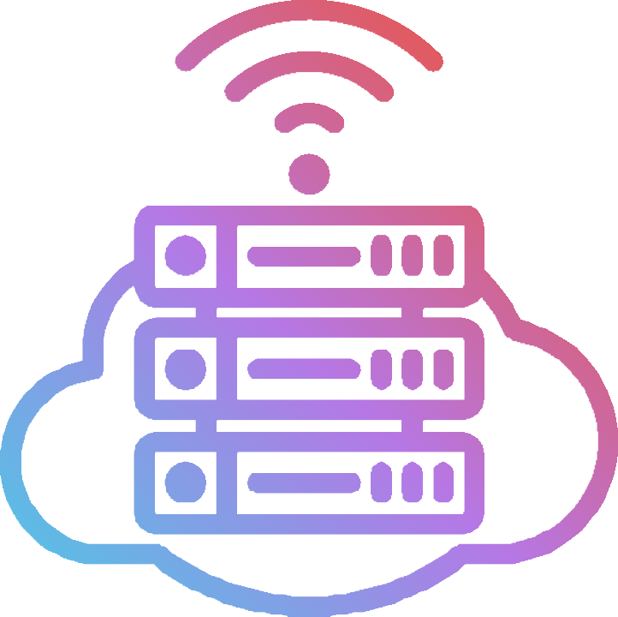

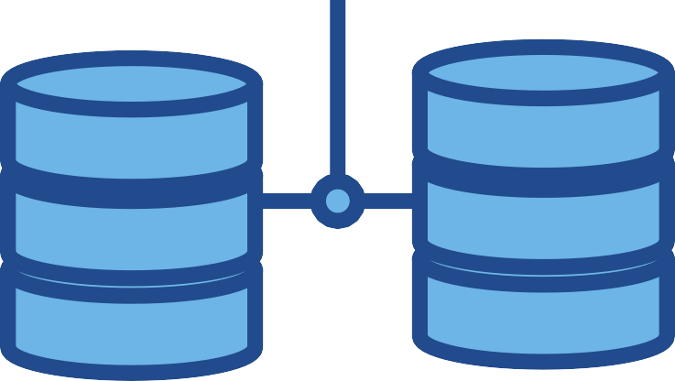

Slide 12





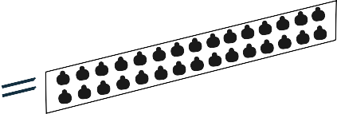
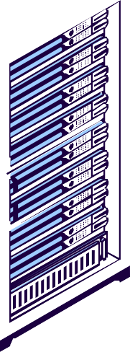
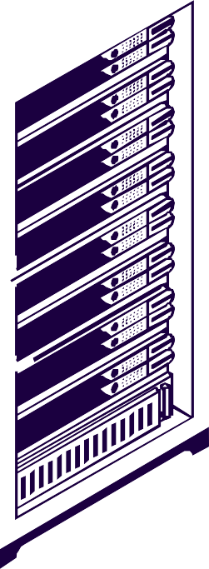

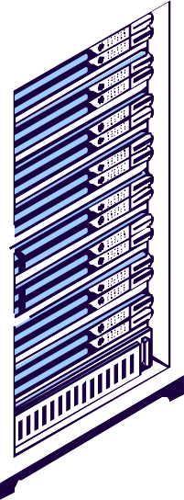

Slide 13

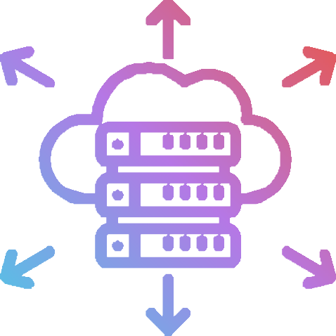
AWS AZURE GCP...

Slide 14

IaaS PaaS SaaS
STEMUP
TYPES OF CLOUD COMPUTING

Slide 15
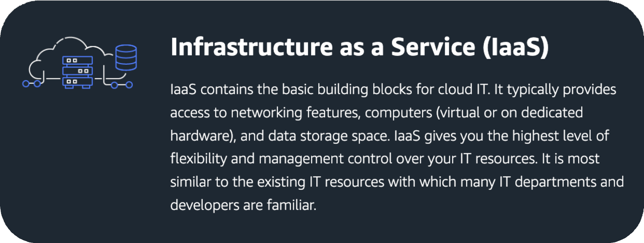

Slide 16

IaaS

Slide 17
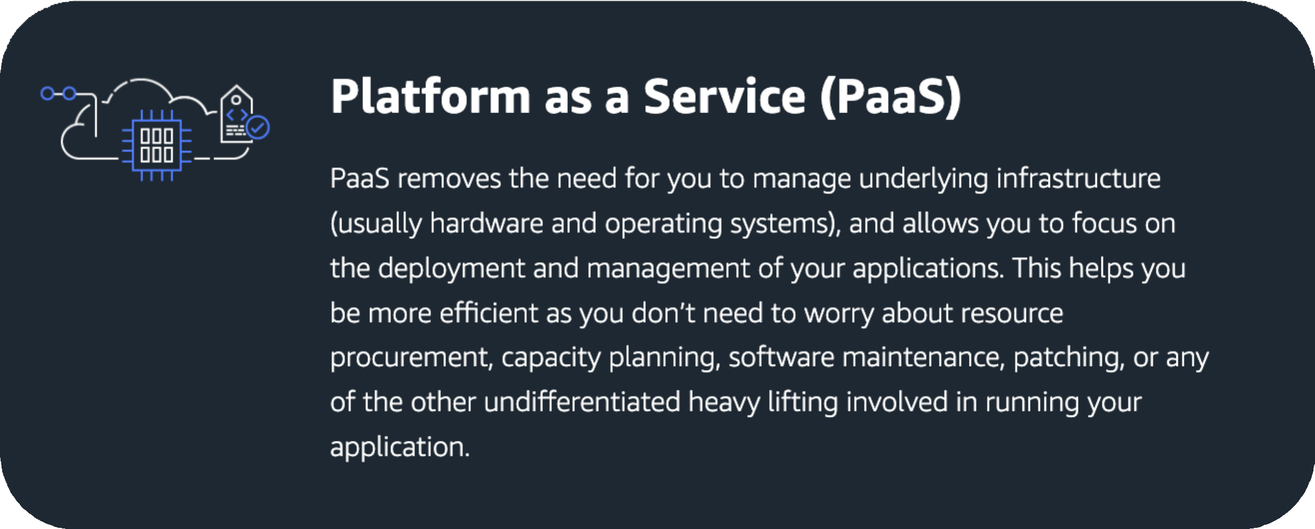

Slide 18

PaaS

Slide 19
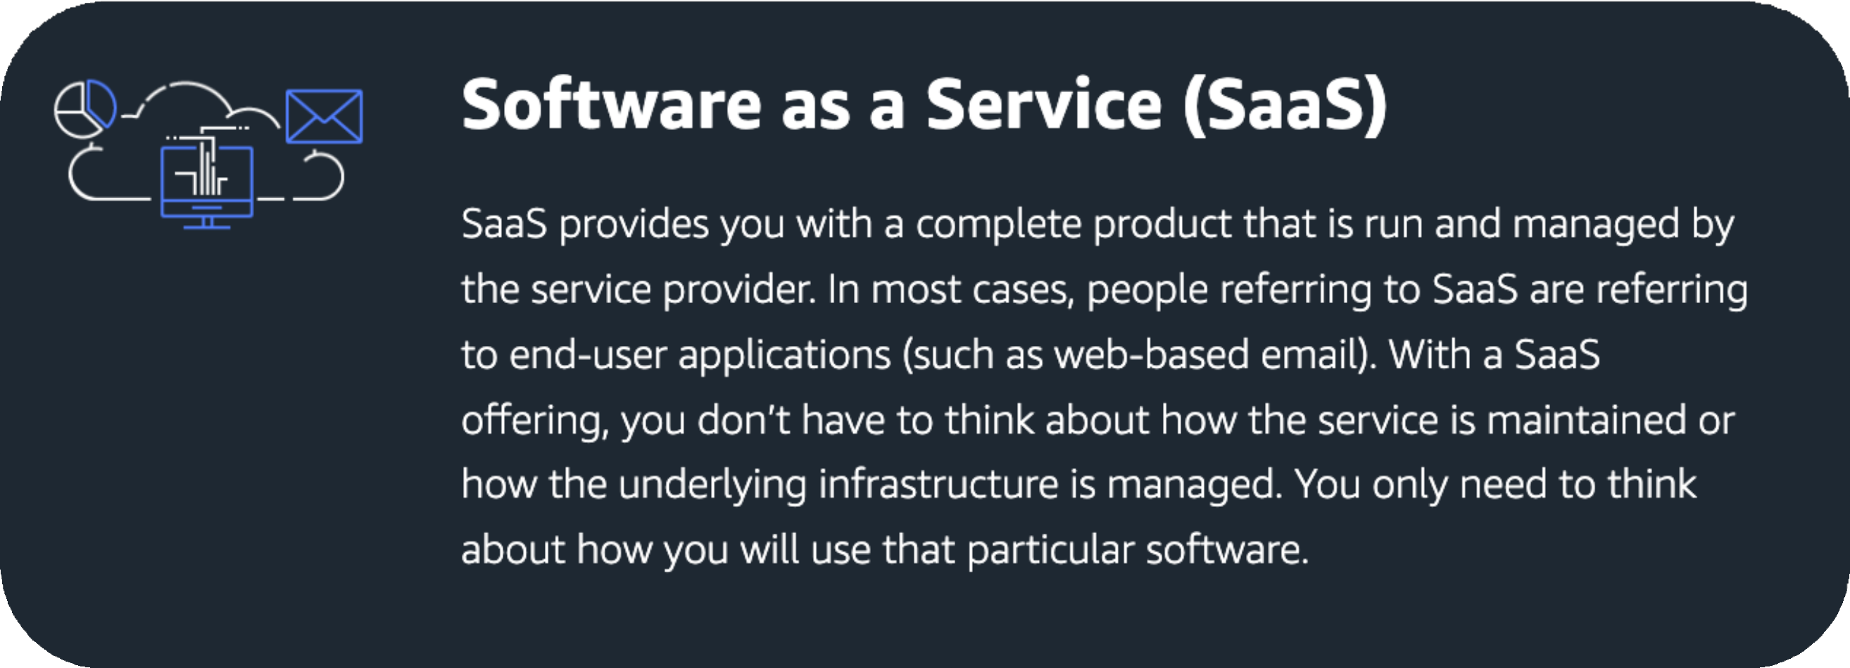

Slide 20

SaaS

Slide 21
DIFFERENT TYPES OF CLOUD DEPLOYMENTS:
PUBLIC CLOUD, PRIVATE CLOUD, AND HYBRID CLOUD.

Slide 22
Public Cloud: A shared cloud environment where multiple users can access services over the internet, like AWS or Azure.
Private Cloud: A dedicated cloud environment for one organization, offering more control and privacy.
Hybrid Cloud: A mix of public and private clouds, allowing data and applications to move between them for flexibility.

Slide 23

FEW FEATURES COMMONLY OFFERED BY CLOUD PROVIDERS:
COMPUTE SERVICES STORAGE SERVICES DATABASE SERVICES NETWORKING SERVICES CONTAINER SERVICES SERVERLESS COMPUTING MACHINE LEARNING SERVICES
IDENTITY AND ACCESS MANAGEMENT (IAM)

Slide 24


MONITORING AND LOGGING CONTENT DELIVERY NETWORK (CDN) BACKUP AND DISASTER RECOVERY SECURITY AND COMPLIANCE TOOLS VIRTUAL PRIVATE CLOUD (VPC) DATA ANALYTICS SERVICES
API MANAGEMENT

